Slide 1
The Basic Problem
Identifing the GPs given by users.
(whether it can mashable or not)
Ranking the candidate GPs
Optional task: modified the user’s selected mashlets and make it a better mashup.

Slide 2
How to deal with it ?

Slide 3
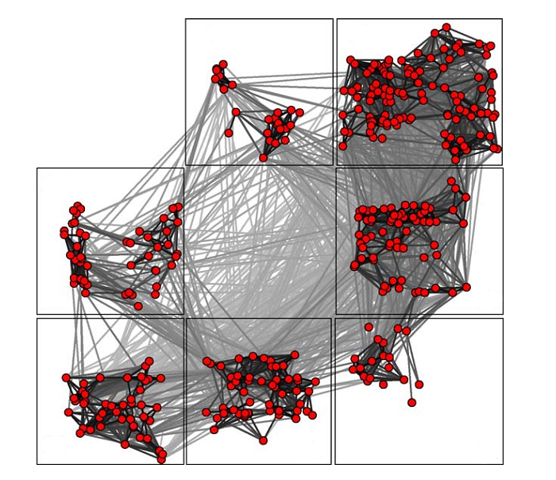
Using cluster analysis
Cluster the APIs by outputs and inputs
The metric can be defined as the probability connected between each other

Slide 4
Using the cluster technique, we can always change our mind from a specific mashlet to a group of mashlets with the same inputs/outpus, in additions, it is more convenient to use some gragh or SNA algorithm to generate the routes between GPs

Slide 5
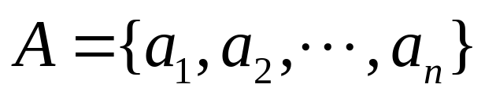
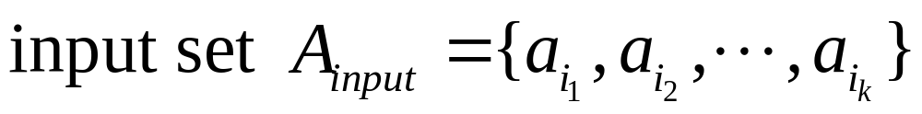
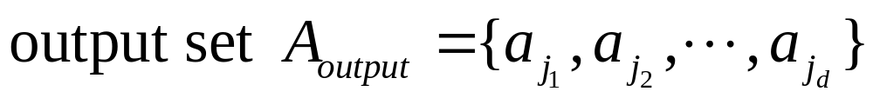
We can use input/output data type by
So for every mashlet m, it may contain a input set and an output set:
Input set
m
Output set

Slide 6
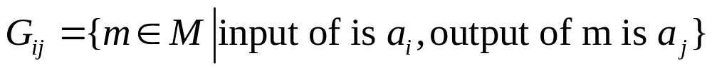
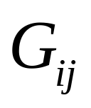
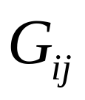
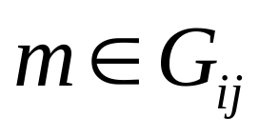
And then we can define
All the can define a cluster of M.
So for every m, there exist a such that , maybe there exist more than one

Slide 7
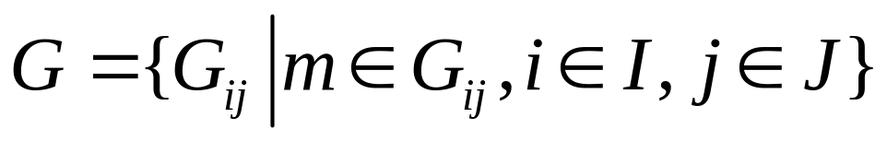
Identifing the GPs given by users.
To identifie is to find IO(input/output) set G:

Slide 8

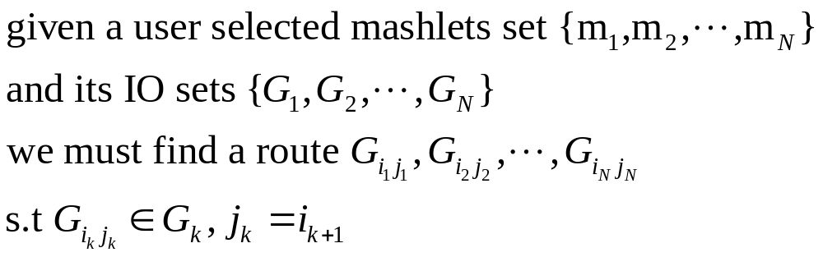
Ranking the candidate GPs
1.Defined link:
2. Generate a directed Graph

Slide 9
Ranking the candidate GPs
To rank the candidate GPs is to find a best route contained in the directed Graph derivated from IO sets.
B
C
A

Slide 10
Some further study are still in process.

